Slide 1
Analysing the customer relationship management in hotel chain
Presented by Anurag Abhay Singh
x18104053
National College OF Ireland

Slide 2
Introduction
The hotel industry is volatile industry because of uncertain behaviour of customer and fierce competition
Total cancellation worldwide in hotel industry is around 104 % (Delgado, 2019)
Our paper is designed by mainly focusing hotel chain concern in handling unwanted cancellation of rooms by deriving certain output they can design their room management system
For analysis Rapid miner, R, SPSS mathematical tools are used to calculate relative error rate, accuracy in predicting probability the customer booking status

Slide 3
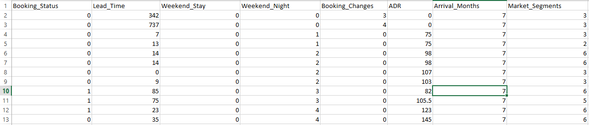
Dataset Analysed & Hypothesis
H0- The Lead times, number of weekdays and weekend night is having significance on booking demand.
H1-The lead times, number of weekdays and weekend night don’t have any significance on booking demand.

Slide 4
Methodologies
Linear Regression: SPSS tool is used to obtain linear relationship between one dependent and one or more independent variable.
Logistic regression are used for nonlinear variable to obtain predictive analysis.
Naïve Bayes: It’s a classification technique used by rapid miner tool to show probability of new customer falling in which category of booking status.
Decision trees: It will classify as new booking will fall in which region of booking status on basis of range of independent variables

Slide 5
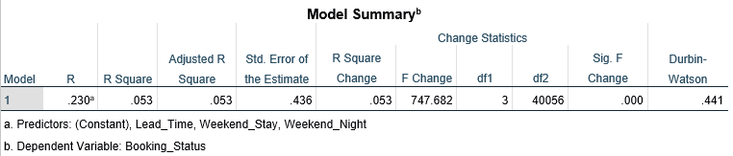
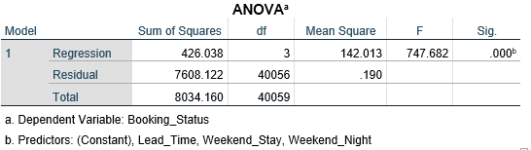
Results
Linear regression by results spss tool

Slide 6
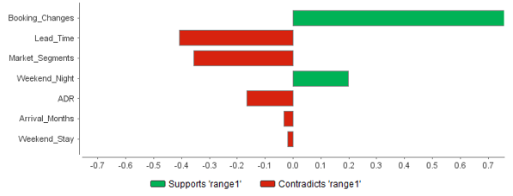

Logistic regression results by rapid miner tool
Logistic regression by rapid miner results
Logistic regression results by spss tool

Slide 7
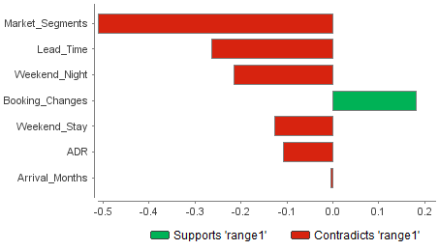
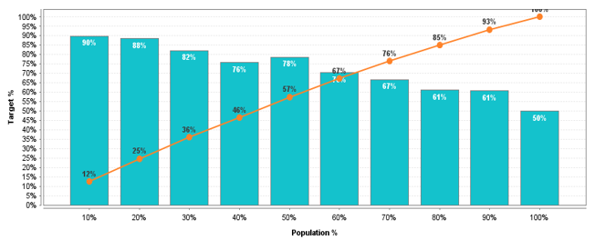
Naïve Bayes results by rapid miner tool

Slide 8
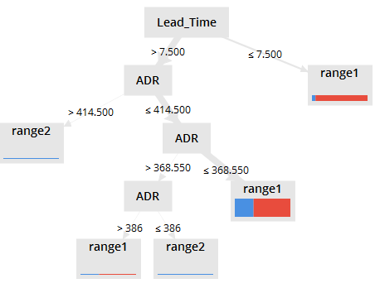
Decision results by rapid miner tool

Slide 9
Conclusion
The results obtained clearly shows the lead time, weekday stay, weekend night and booking changes by customer have impact on booking status.
The results show booking changes of 20% feature control 67% of booking status population.
The lead time is also important parameter to understand the booking scenario as one with lead time less than 7.5 days have higher chances of booking room and spending around 368.50$ weekly.

